Slide 1
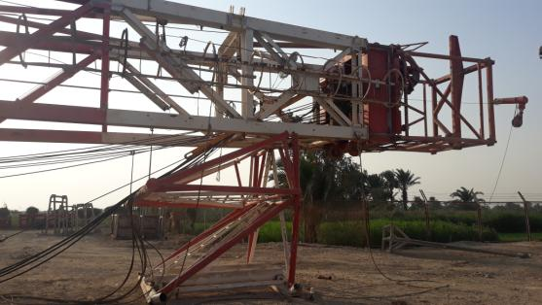

SAFETY
FLASH ALERT
Classification Of Accident | DATE | Violation Category | LOCATION
Property damage | 30-8-2022 | Bypassing Safety Controls | Mast
What happened ?!!
In preparation to raise mast that was already on high mast stand at crown section and the monkey board fitted to the second section from top. Crew were stringing in the drill line with two crew members on crown block sides to guide the drill line through sheaves. Suddenly the mast stand failed at a welding point causing the mast to rest on monkey board structure that caused the second mast section to bend, The two crew members were wearing the safety harness that saved them from falling to ground .
LESSONS LEARNED ?
Direct Cause:
Failure of mast supporting rack at its welding joints.
Always inspect any tools, equipment and lifting accessories before using .
Insure that all items in the rig inspected and have valid certificate .
Root Cause:
Unfortunately, Mast supporting racks not inspected before
Please disseminate this Accident notification to your teams and use it in your tool box talks and HSE meetings and notice boards.

